Slide 1
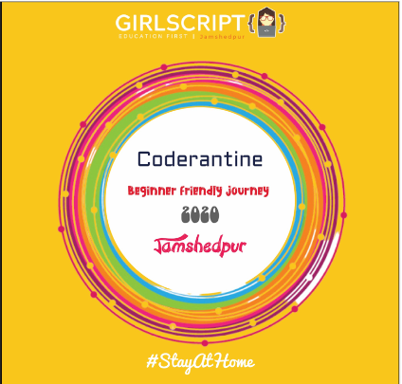
Python Programming
Day -5

Slide 2
Lambda Functions
And Regular expressions

Slide 3
Today’s Topics
What are Lambda Functions?
Their characteristics
Purpose of lambda functions
How to write them?
Use of lambda functions in user defined functions
Regular expressions a simple intro

Slide 4

What are Lambda Functions??
In Python,we use the lambda keyword to declare an anonymous function, which is why we refer to them as "lambda functions". An anonymous function refers to a function declared with no name.
Although syntactically they look different, lambda functions behave in the same way as regular functions that are declared using the def keyword.
They have some special characteristics that makes it slightly different from other functions of python

Slide 5
Characteristics of a Lambda Function
A lambda function can take any number of arguments, but they contain only a single expression. An expression is a piece of code executed by the lambda function, which may or may not return any value.
Lambda functions can be used to return function objects.
Syntactically, lambda functions are restricted to only a single expression.

Slide 6
Creating a lambda function
Use the following syntax to declare a lambda function
lambda :”specify the function”
lambda a1:”specify purpose of a1”
Lambda a1…an: ”specify purpose of a1..an”
As stated above, we can have any number of arguments but only a single expression. The lambda operator cannot have any statements and it returns a function object that we can assign to any variable.
Ex:remainder = lambda num: num % 2
print(remainder(5))

Slide 7
Why do we need lambda function?
Lambda functions provide an elegant and powerful way to perform operations using built-in methods in Python. It is possible because lambdas can be invoked immediately and passed as an argument to these functions.
IIFE in Python Lambda
IIFE stands for immediately invoked function execution. It means that a lambda function is callable as soon as it is defined.
Let us see more!!!!!

Slide 8
Mainly used for one-time usage so it is also know as throw-away functions.
Reduce code size as lambda functions are usually one-liners.
Passed as input or returned as output from higher order functions.

Slide 9
lambdas in filter()
The filter function is used to select some particular elements from a sequence of elements. The sequence can be any iterator like lists, sets, tuples, etc.
The elements which will be selected is based on some pre-defined constraint. It takes 2 parameters:
A function that defines the filtering constraint
A sequence (any iterator like lists, tuples, etc.)

Slide 10
EXAMPLE AND EXPLANATION
sequences = [10,2,8,7,5,4,3,11,0, 1]
filtered_result = filter (lambda x: x > 4, sequences)
print(list(filtered_result))
OUTPUT:
[10, 8, 7, 5, 11]
In the first statement, we define a list called sequences which contains some numbers.
Here, we declare a variable called filtered_result, which will store the filtered values returned by the filter() function.
A lambda function which runs on each element of the list and returns true if it is greater than 4.
Print the result returned by the filter function.

Slide 11
Lambdas in map()
The map function is used to apply a particular operation to every element in a sequence. Like filter(), it also takes 2 parameters:
A function that defines the op to perform on the elements
One or more sequences

Slide 12
EXAMPLE AND EXPLANATION
sequences = [10,2,8,7,5,4,3,11,0, 1]
filtered_result = map (lambda x: x*x, sequences)
print(list(filtered_result))
Here, we define a list called sequences which contains some numbers.
We declare a variable called filtered_result which will store the mapped values
A lambda function which runs on each element of the list and returns the square of that number.
Print the result returned by the map function.

Slide 13
Lambdas in reduce()
The reduce function, like map(), is used to apply an operation to every element in a sequence. However, it differs from the map in its working. These are the steps followed by the reduce() function to compute an output:
Perform the defined operation on the first 2 elements of the sequence.
Save this result
Perform the operation with the saved result and the next element in the sequence.
Repeat until no more elements are left.

Slide 14
EXAMPLE AND EXPLANATION
Here, we define a list called sequences which contains some numbers.
We declare a variable called product which will store the reduced value
A lambda function that runs on each element of the list. It will return the product of that number as per the previous result.
Print the result returned by the reduce function.
from functools import reduce
sequences = [1,2,3,4,5]
product = reduce (lambda x, y: x*y, sequences)
print(product)
OUTPUT :120

Slide 15
Summary
Lambdas, also known as anonymous functions, are small, restricted functions which do not need a name (i.e., an identifier).
Every lambda function in Python has 3 essential parts:
The lambda keyword.
The parameters (or bound variables), and
The function body.
The syntax for writing a lambda is: lambda parameter: expression
Lambdas can have any number of parameters, but they are not enclosed in braces
At the bytecode level, there is not much difference between how lambdas and regular functions are handled by the interpreter.

Slide 16
Lambdas support IIFE thru this syntax: (lambda parameter: expression)(argument)
Lambdas are commonly used with the following python built-ins:
Filter: filter (lambda parameter: expression, iterable-sequence)
Map: map (lambda parameter: expression, iterable-sequences)
Reduce: reduce (lambda parameter1, parameter2: expression, iterable-sequence)
Do not write complicated lambda functions in a production environment because it will be difficult for code-maintainers.

Slide 17
Regular Expressions
In computing, a regular expression, also referred to as “regex” or “regexp”, provides a concise and flexible means for matching strings of text, such as particular characters, words, or patterns of characters. A regular expression is written in a formal language that can be interpreted by a regular expression processor.

Slide 18
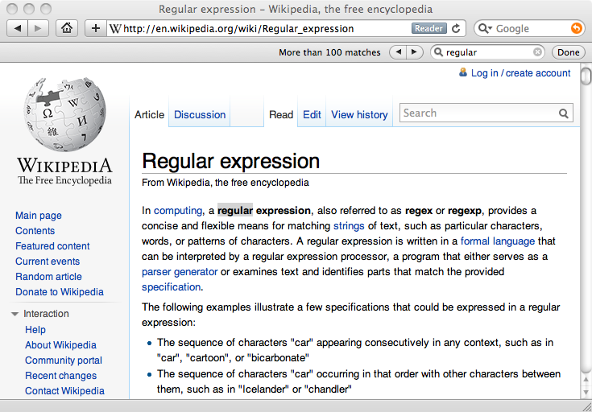
Really smart "Find" or "Search"

Slide 19
REGEX AND TEXT HAVE THEIR OWN CURSOR
STRING
C | O | D | E | R | A | N | T | I | N | E
REGEX
C | O | D | E

Slide 20
Understanding Regular Expressions
Very powerful and quite cryptic
Fun once you understand them
Regular expressions are a language unto themselves
A language of “marker characters” - programming with characters
It is kind of an “old school” language - compact

Slide 21
Regular Expression Quick Guide
^ Matches the beginning of a line
$ Matches the end of the line
. Matches any character
\s Matches whitespace
\S Matches any non-whitespace character
* Repeats a character zero or more times
*? Repeats a character zero or more times (non-greedy)
+ Repeats a character one or more times
+? Repeats a character one or more times (non-greedy)
[aeiou] Matches a single character in the listed set
[^XYZ] Matches a single character not in the listed set
[a-z0-9] The set of characters can include a range
( Indicates where string extraction is to start
) Indicates where string extraction is to end

Slide 22
The Regular Expression Module
Before you can use regular expressions in your program, you must import the library using "import re"
You can use re.search() to see if a string matches a regular expression, similar to using the find() method for strings
You can use re.findall() extract portions of a string that match your regular expression similar to a combination of find() and slicing: var[5:10]

Slide 23
Widely used functions in Regex
Function | Description
findall | Returns a list containing all matches
search | Returns a match object if there is a match anywhere in the string
split | Returns a list where the string has been split at each match
sub | Replaces one or many matches with a string

Slide 24
Using re.search() like find()
import re
hand = open('mbox-short.txt')
for line in hand:
line = line.rstrip()
if re.search('From:', line) :
print line
hand = open('mbox-short.txt')
for line in hand:
line = line.rstrip()
if line.find('From:') >= 0:
print line

Slide 25
Using re.search() like startswith()
import re
hand = open('mbox-short.txt')
for line in hand:
line = line.rstrip()
if re.search('^From:', line) :
print line
hand = open('mbox-short.txt')
for line in hand:
line = line.rstrip()
if line.startswith('From:') :
print line
We fine-tune what is matched by adding special characters to the string

Slide 26
Pandas-for handling csv files and large data NumPy- for many mathematical modules Keras-for implementing many machine learning algorithms Smtplib- for automatically sending e-mail requests-for implementing API Django-for web development framework TensorFlow -for implementing machine learning modules like CNN,KNN etc.,
POPULAR PYTHON MODULES

Slide 27
THANK YOU

